Slide 1
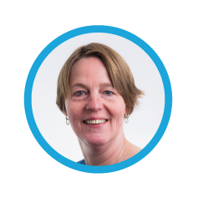
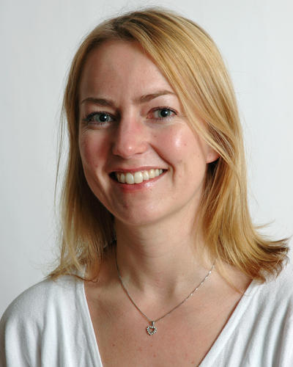
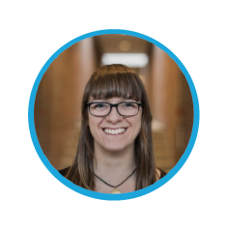
Training Methods
Ricarda Braukmann (DANS)
RDM Expert Tour Guide:
Train the Trainers
12-13 April 2018, Ljubljana
Cite as: Braukmann (2018). The CESSDA Expert Tour Guide –Training Methods [presentation]. Bergen: CESSDA ERIC.

Slide 2
Starter Package Tips for Trainers

Slide 3
Starter Package
Gunn Inger Lyse Samdal
(NSD)
Notes:
Screen Shot 2018-03-27 at 11.06.11

Slide 4
Starter Package
Package for trainers that contains materials for local workshops
PDFs of the online chapters later this year
Today’s presentations + handouts
High-resolution images used in the Module
Flyer of the Module
Example workshop outlines
Example exercises + model answers
Example workshop evaluation form later this year
…
Gunn Inger Lyse Samdal
(NSD)
Notes:
Screen Shot 2018-03-27 at 11.06.11

Slide 5
Starter Package
What else would you need?
Notes:
Screen Shot 2018-03-27 at 11.06.11

Slide 6
Starter Package
Two example workshop outlines
One Day workshop
Up to 30 participants
Based on the CESSDA Expert Tour Guide
1: Research Data Management
2: Ethical and legal considerations in Research Data Management
Gunn Inger Lyse Samdal
(NSD)
Notes:
Screen Shot 2018-03-27 at 11.06.11

Slide 7
Starter Package
1: Research Data Management
General workshop on RDM
Presentation: Introduction to RDM (based on the module content)
Assignment block
Presentation: Best practices and where to find information (partially based on the module content)
Assignment block
Includes: Description of the program, links to the module, assignment suggestions, background reading, etc.
Gunn Inger Lyse Samdal
(NSD)
Notes:
Screen Shot 2018-03-27 at 11.06.11

Slide 8
Starter Package
2: Ethical and legal considerations in Research Data Management
Content-specific workshop on ethical and legal considerations in RDM
Presentation: Personal data and copyright: Basic concepts (based on the module content)
Assignment blocks
Includes: Description of the program, links to the module, assignment suggestion, background reading, etc.
Gunn Inger Lyse Samdal
(NSD)
Notes:
Screen Shot 2018-03-27 at 11.06.11

Slide 9
Starter Package
Other topics for workshops?
Notes:
Screen Shot 2018-03-27 at 11.06.11

Slide 10
Starter Package
Other topics for workshops?
documentation
data management planning
sensitive data
GDPR
storing
data curation
sharing
Focus on specific (data) problems
archiving
social media data
Notes:
Screen Shot 2018-03-27 at 11.06.11

Slide 11
Tips for Trainers
Veerle Van den Eynden
(UKDS)
Ellen Leenarts
(DANS)
Notes:
Screen Shot 2018-03-27 at 11.06.11

Slide 12
Tips for Trainers
What works well in a one-day RDM workshop for researchers?
Active learning is
making processes visible
directly experiencing methods
critical reflection on practice
This can be done through
practical tasks and exercises
developing an own DMP, consent form, etc.
group discussions of real-case data challenges
Veerle Van den Eynden
(UKDS)
Ellen Leenarts
(DANS)
Notes:
Screen Shot 2018-03-27 at 11.06.11

Slide 13
Tips for Trainers
Target audience
Workshop set-up
Engaging with the participants
Practical matters
Veerle Van den Eynden
(UKDS)
Ellen Leenarts
(DANS)
Notes:
Screen Shot 2018-03-27 at 11.06.11

Slide 14
Think of the best workshop ever
Target audience
Workshop set-up
Engaging with the audience
Practical issues
Notes:
Screen Shot 2018-03-27 at 11.06.11

Slide 15
Our experience
Target audience
Groups of 20 - 30 researchers max
Sometimes specifically for junior researchers
But: Mixed audience can help discussion
For researchers who do research with people (social sciences +)
Veerle Van den Eynden
(UKDS)
Ellen Leenarts
(DANS)
Notes:
Screen Shot 2018-03-27 at 11.06.11

Slide 16
Think of the best workshop ever
Workshop set-up
Engaging with the audience
Practical issues
Notes:
Screen Shot 2018-03-27 at 11.06.11

Slide 17
Our experience
Workshop set-up
Introduction: Get to know each other!
Presentations: Short and interactive
Experts, case studies, personal experiences, tool demonstrations
Exercises: Pick concise tasks and plan enough time
Break out groups & panel discussion of key findings
Closing: Include a round-up session
Preparation: Have participants read up, prepare exercises, or send materials
→ Be create and adapt examples to your audience and your needs!
Veerle Van den Eynden
(UKDS)
Ellen Leenarts
(DANS)
Notes:
Screen Shot 2018-03-27 at 11.06.11

Slide 18
Think of the best workshop ever
Engaging with the participants
Notes:
Screen Shot 2018-03-27 at 11.06.11

Slide 19
Our experience
Engaging with the participants
Ask participants beforehand to
Send questions or topics
Send materials from their own research (e.g.: DMP, consent form)
Start the day with an introduction round
Move around the room during group discussions
Use live polling (especially for larger groups)
Veerle Van den Eynden
(UKDS)
Ellen Leenarts
(DANS)
Notes:
Screen Shot 2018-03-27 at 11.06.11

Slide 20
Think of the best workshop ever
Practical matters
Notes:
Screen Shot 2018-03-27 at 11.06.11

Slide 21
Our experience
Practical matters
Always offer lunch or pizza!
Announce the workshop well in advance, e.g. in local university newsletters
Provide a clear program in the announcement
Assess the room set-up beforehand
Is it a nice atmosphere suitable for group work?
Do you have internet access/power for laptops?
Plan enough time for (lunch) breaks and for sessions to run over
Make slides and handouts available (afterwards) to participants
Prepare an evaluation round or form to receive feedback
Veerle Van den Eynden
(UKDS)
Ellen Leenarts
(DANS)
Notes:
Screen Shot 2018-03-27 at 11.06.11

Slide 22
Any questions?

