Slide 1

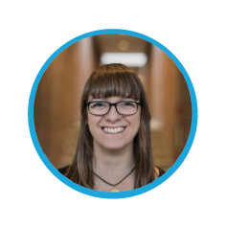

Structure of the Guide
CESSDA.eu/DMGuide
Ricarda Braukmann (DANS)
RDM Expert Tour Guide:
Train the Trainers
12-13 April 2018, Ljubljana
Cite as: Braukmann (2018). The CESSDA Expert Tour Guide – Structure of the Guide [presentation]. Bergen: CESSDA ERIC.

Slide 2
CESSDA Project in 2017
Why this online module?
A lot of DM knowledge and training within individual CESSDA archives
The online module enables us to
Share good training practices, examples and content
Outline European diversity and commonalities (DMP templates, ethics, etc.)
Create opportunity for individual researchers for self-study
Create a basis for local workshops that can build around centrally updated content

Slide 3
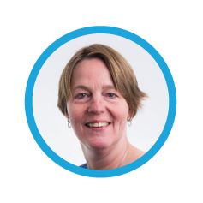
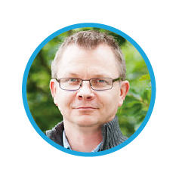
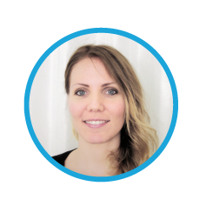
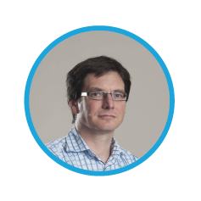
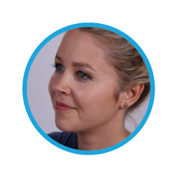

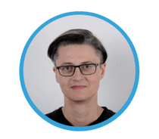
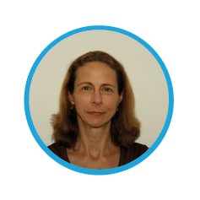

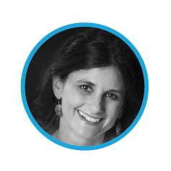
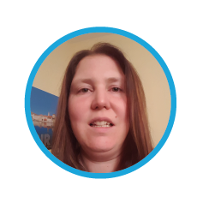
CESSDA Project in 2017
Several CESSDA archives were involved in the realization of the module
The Expert Tour Guide on Data Management is created for CESSDA ERIC by ADP, AUSSDA, CSDA, DANS, FORS, FSD, GESIS, NSD, SND, So.Da.Net and UKDS and is illustrated and edited by Verbeeldingskr8. The authors are mentioned by name in the overview of the relevant chapter(s). DANS was in the lead of creating this tour guide.
Notes:
Screen Shot 2018-03-27 at 11.06.11

Slide 4
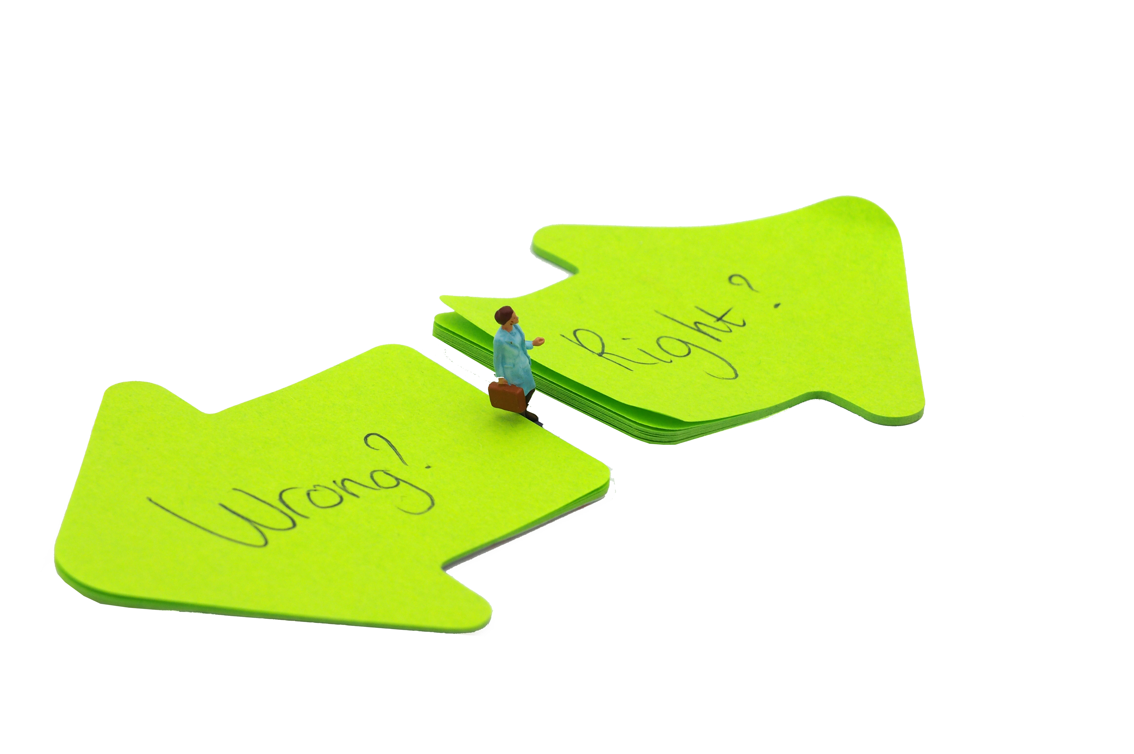

For researchers with researchers

Slide 5
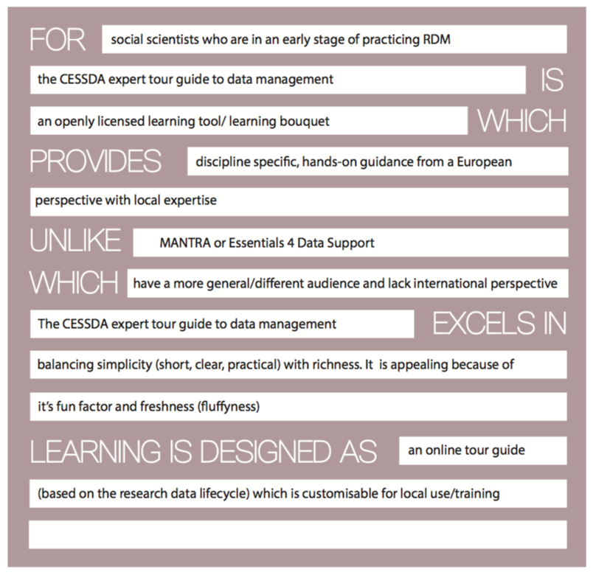

Slide 6
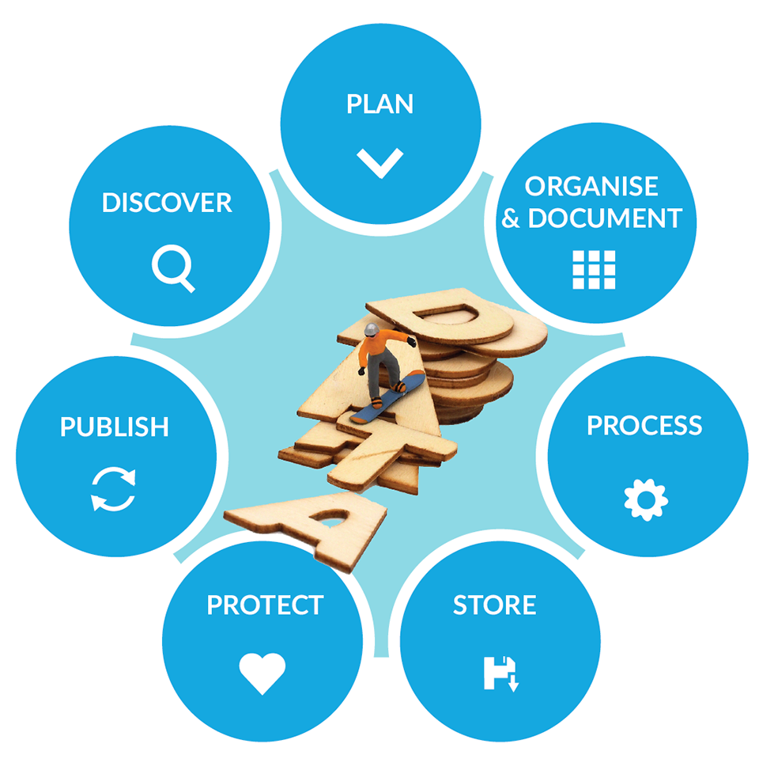
Following the Data Life Cycle
Available end of 2018

Slide 7
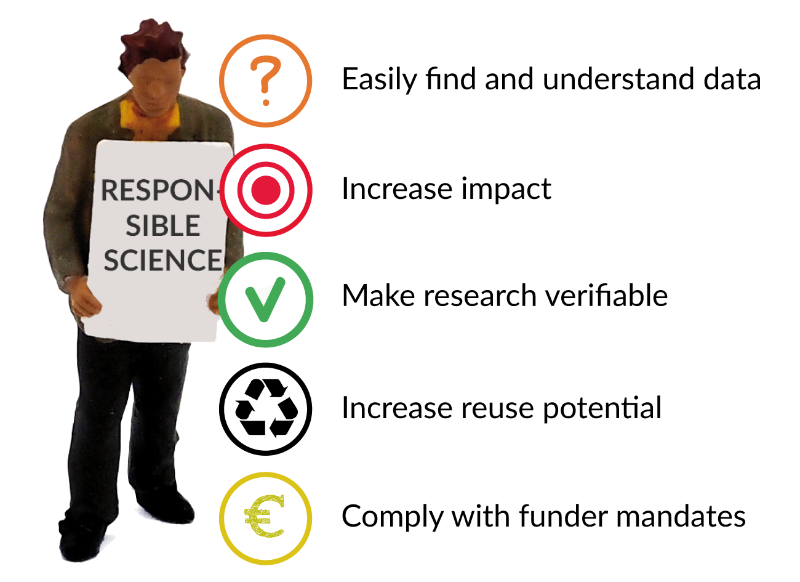

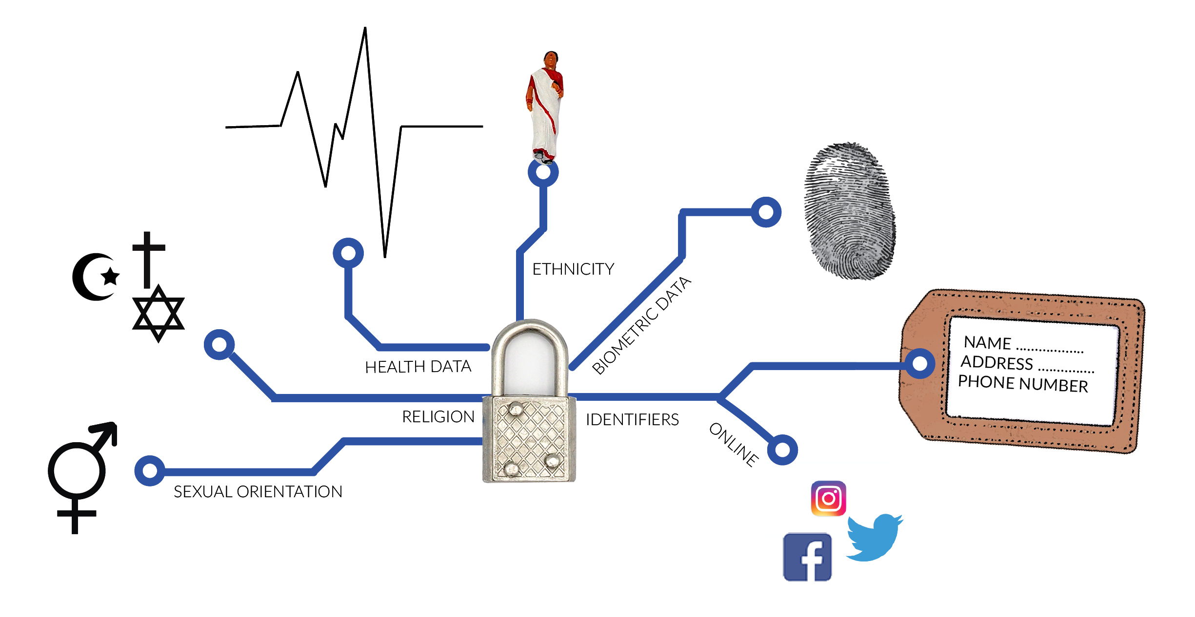
Creating One Guide
Common look and feel through visualisations by Marina Noordegraaf (Verbeeldingskr8)

Slide 8
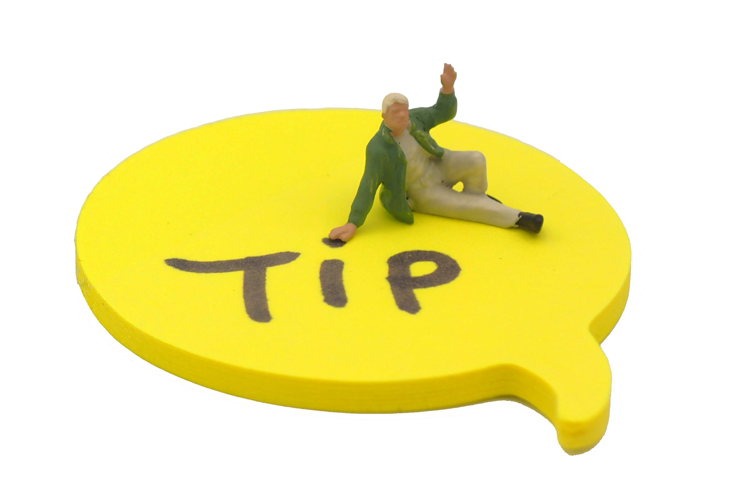
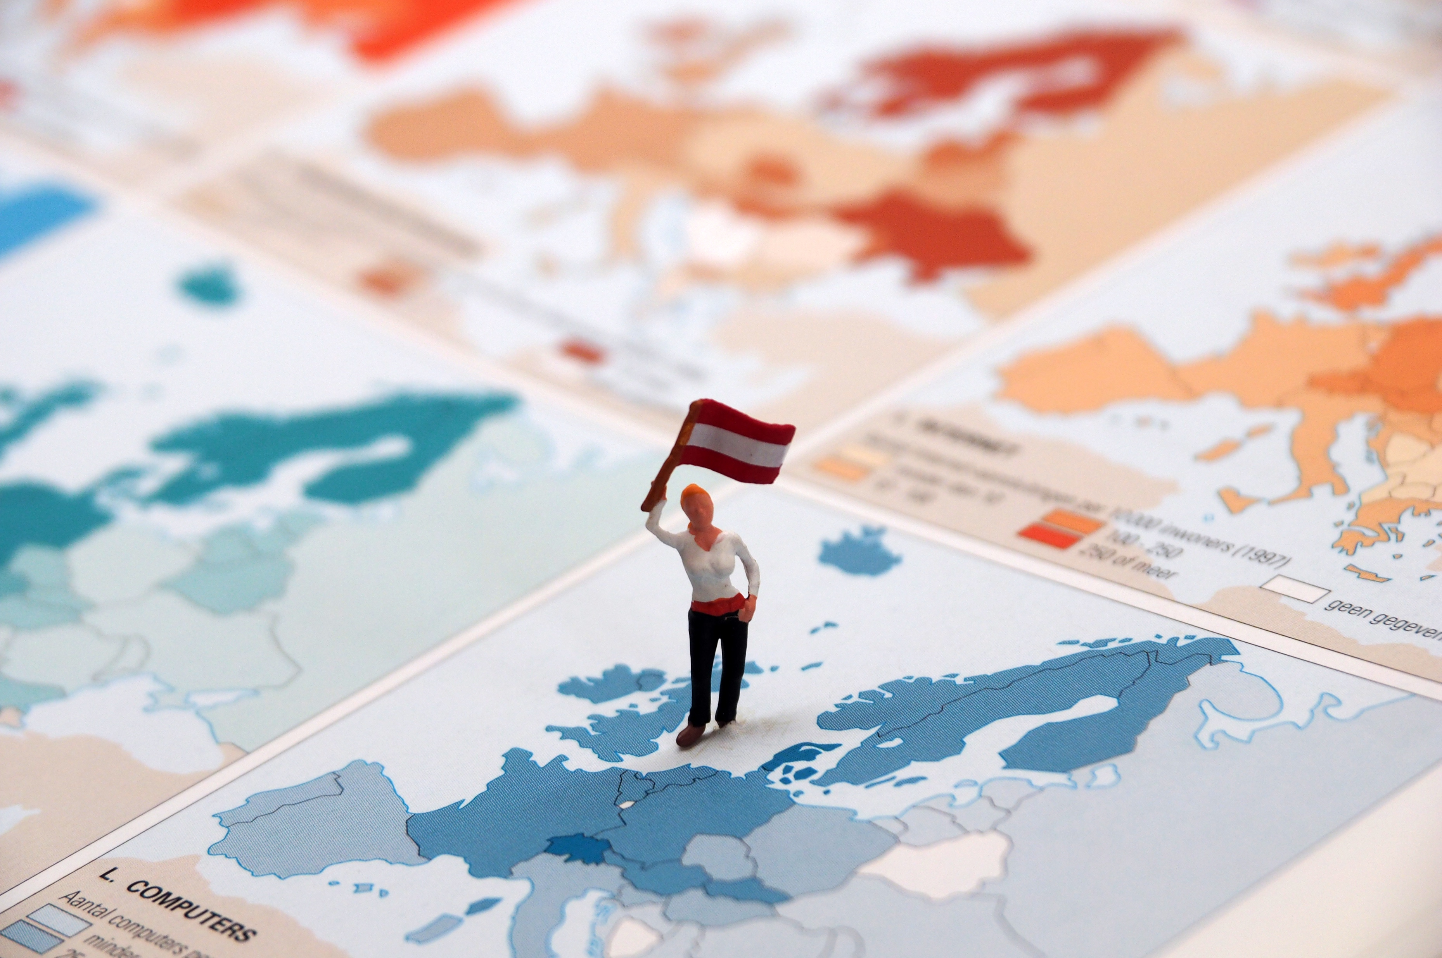
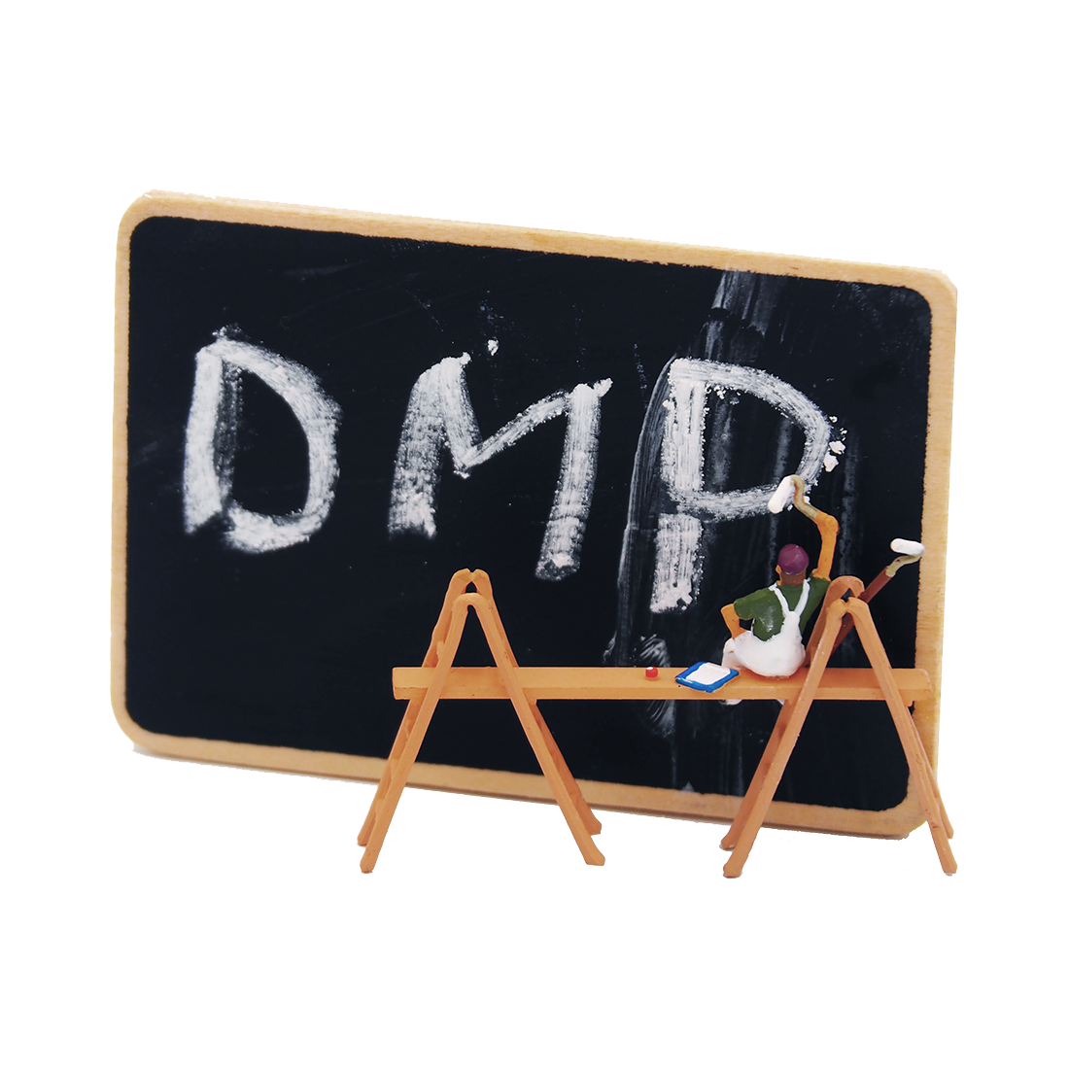
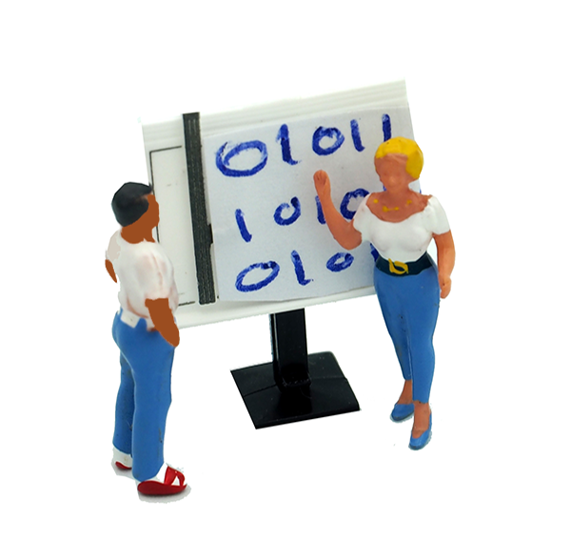
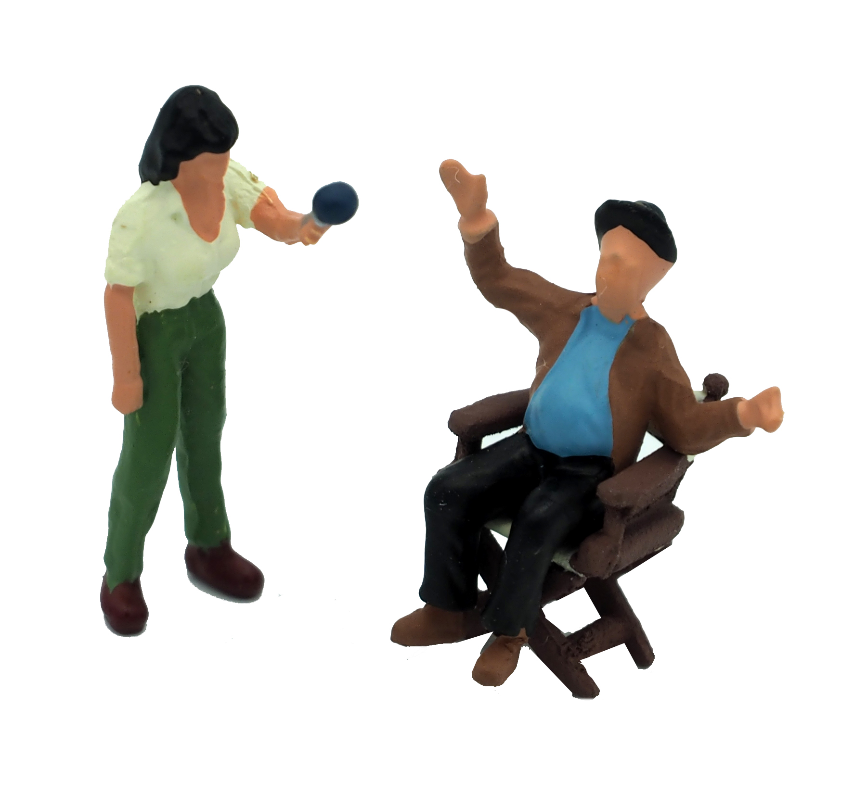
Creating One Guide
Recurring elements in each chapter
Expert Tips
European diversity
Qualitative vs. Quantitative data
Adapt your DMP

Slide 9
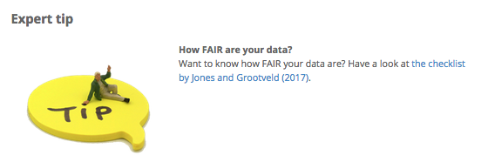
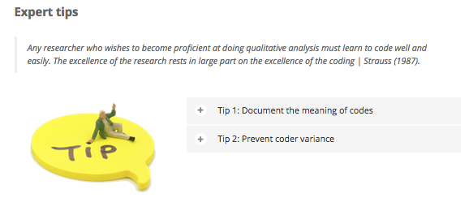
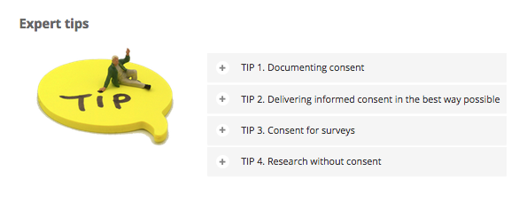
Recurring elements
Expert Tips

Slide 10
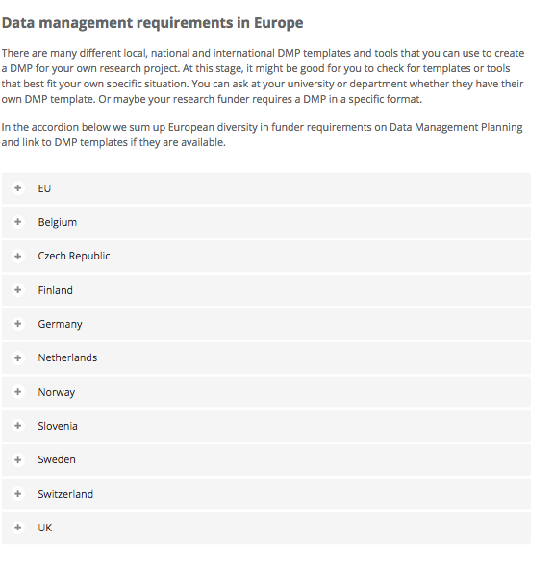
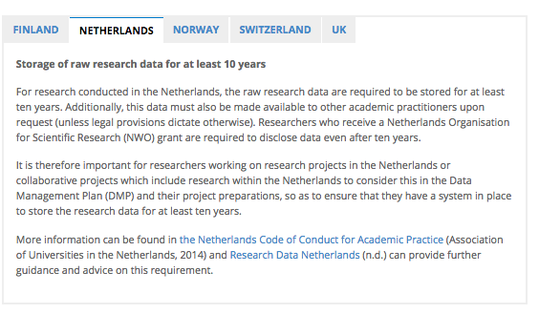
Recurring elements
European diversity

Slide 11
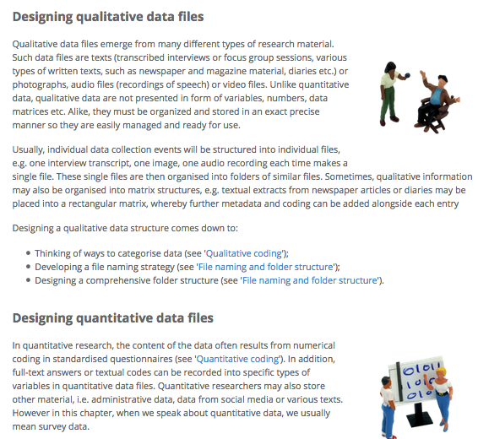
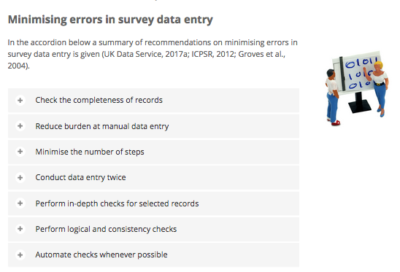
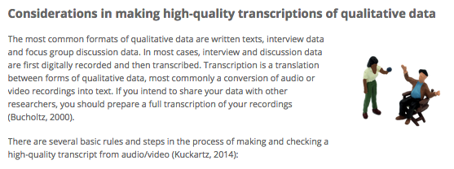
Recurring elements
Qualitative vs. Quantitative data

Slide 12
Recurring elements
Adapt your DMP
Our own DMP checklist (download hier)
Adapt your DMP section at the end of every chapter

Slide 13
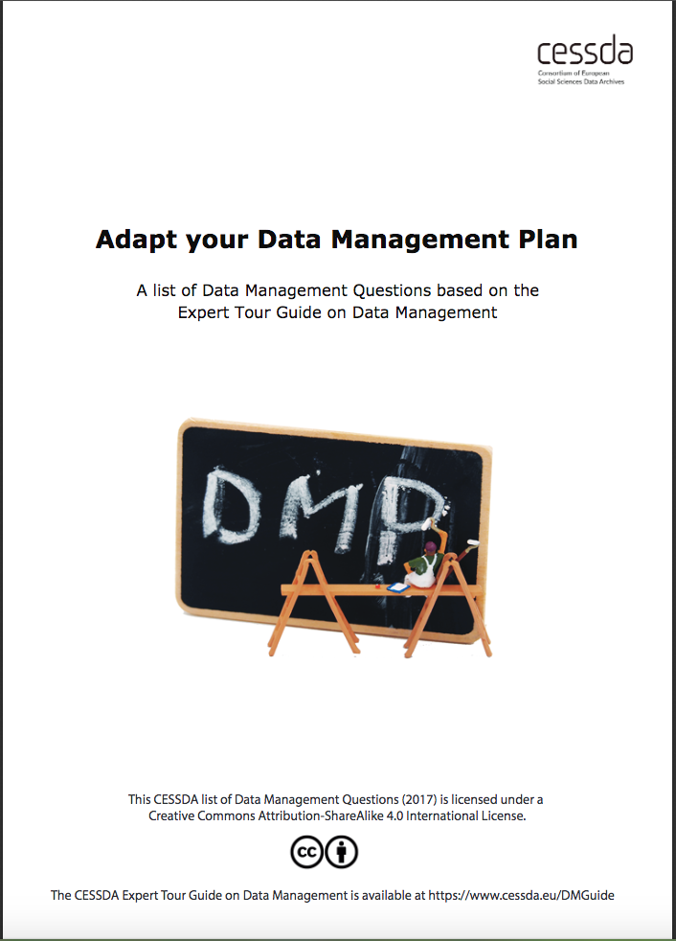
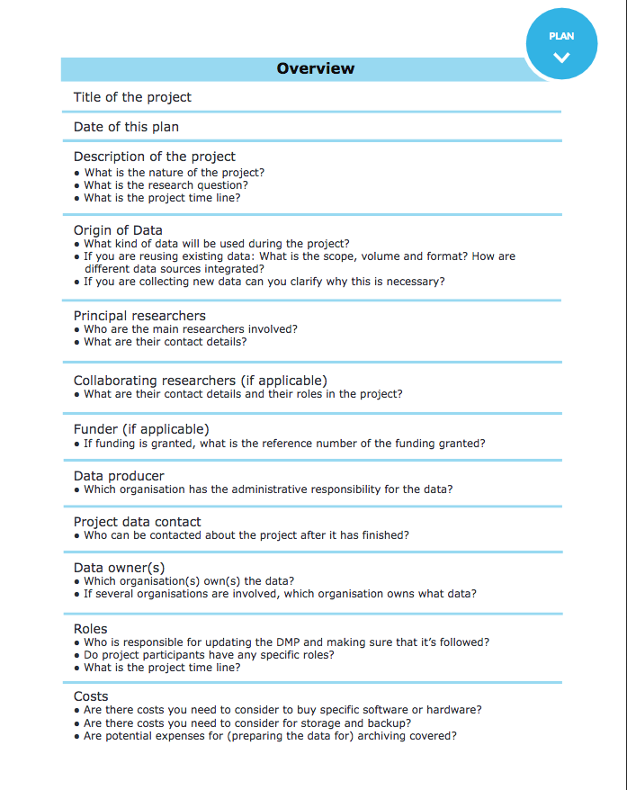
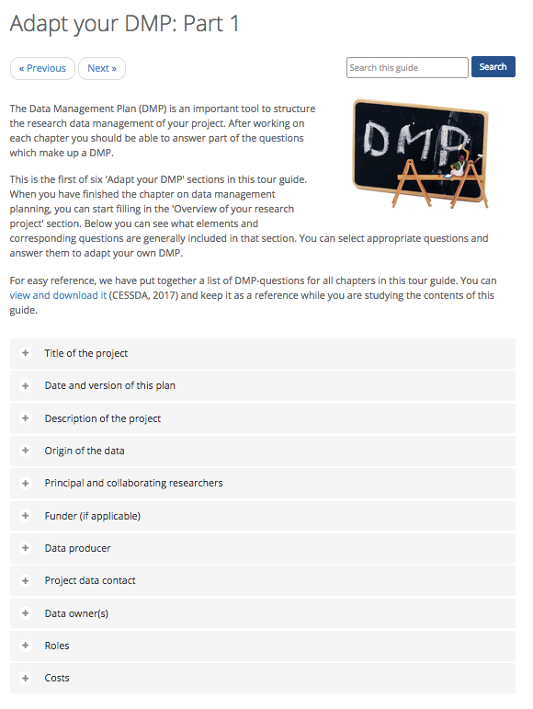
Recurring elements

Slide 14


How the module can be used
The module is open and freely available anywhere anytime via CESSDA.eu/DMGuide
Self-study for researchers (15 - 20 hours of content)
Basis for interactive blended training by trainers or data stewards in (social sciences) research institutes to provide workshops on data management
Train-the-trainer package
The Expert Tour Guide on Data Management by CESSDA ERIC is licensed under a Creative Commons Attribution-ShareAlike 4.0 International License. All material under this license can be freely used, as long as CESSDA ERIC is credited as the author.

Slide 15
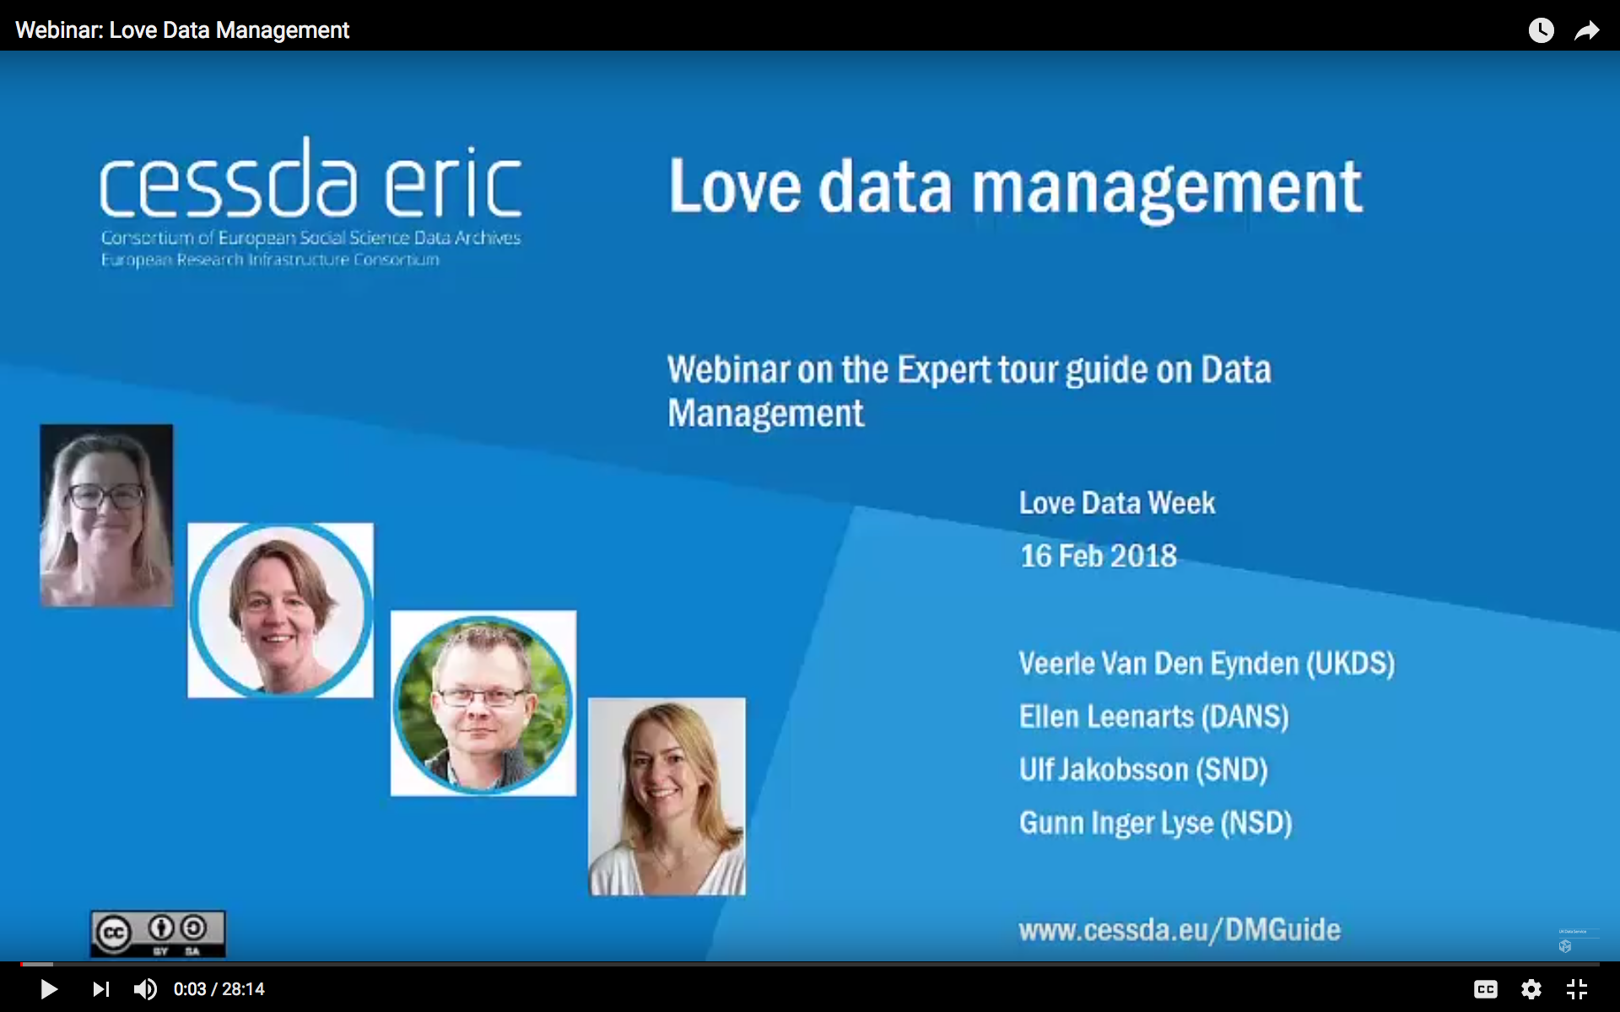
More Information?
Love Data Management Webinar: YouTube recording

Slide 16
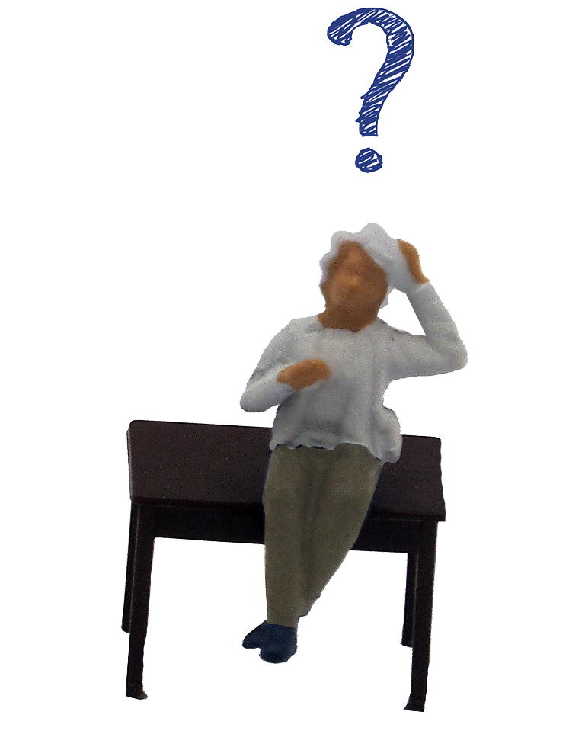
We would love to hear your input!
Contact us via: training@cessda.eu

